Slide 1
NOVEMBER IS FOUNDATION MONTH
Notes:
Welcome message

Slide 2
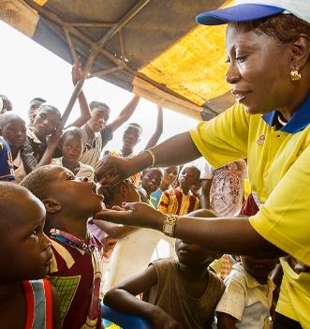

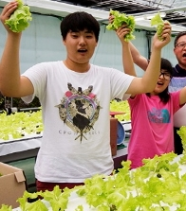
WHAT IS THE ROTARY FOUNDATION?
The mission of The Rotary Foundation is to enable Rotarians to advance world understanding, goodwill, and peace through the improvement of health, the support of education, and the alleviation of poverty.
Notes:
The Rotary Foundation is a primary source of funding for Rotary’s humanitarian activities and Rotary’s effort to eradicate polio worldwide.
Our Foundation is able to achieve its mission through the generous contributions and active participation of Rotarians and friends of Rotary.

Slide 3
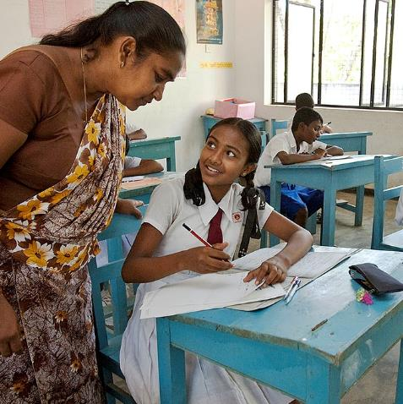
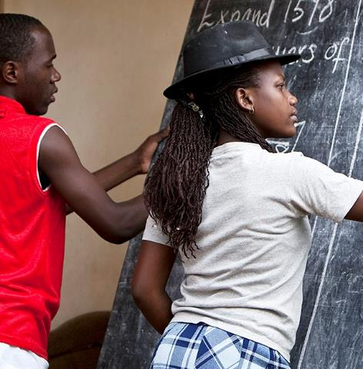
OUR FOUNDATION IS UNIQUE
Notes:
Our Rotary Foundation is unique: It belongs to Rotarians and is dedicated to furthering Rotary programs that address the greatest needs around the world.
Because Rotary clubs operate in nearly every country in the world, Rotarians truly constitute a global network of community volunteers.

Slide 4
OUR SEVEN AREAS OF FOCUS:
Peace and conflict prevention/resolution
Disease prevention and treatment
Water and sanitation
Maternal and child health
Basic education and literacy
Economic and community development
Protecting the Environment
Notes:
Our areas of focus support the Rotary Foundation mission.
Whether it’s educating a scholar in peace and conflict resolution, preventing polio, providing aid to an inner city homeless agency, or supplying books and teaching materials at an elementary school, Rotary creates the environment and circumstances that promote Doing Good in the World.

Slide 5
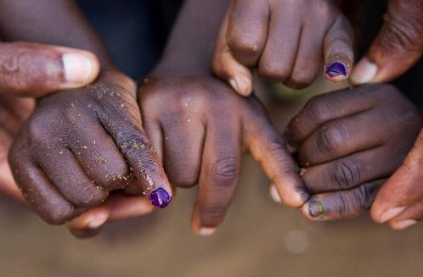
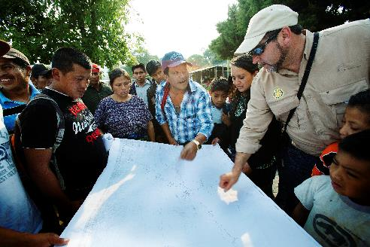
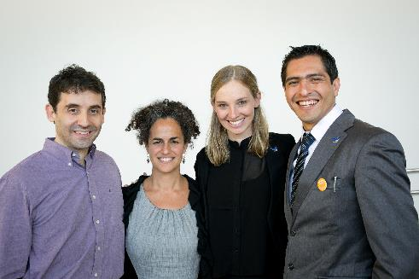
SUPPORTING THE ROTARY FOUNDATION
PolioPlus Fund
End Polio Now
Annual Fund
For Support Today
Endowment Fund
To Secure Tomorrow
Notes:
Rotarians can support three main funds:
The PolioPlus Fund, to help us eradicate polio worldwide.
The Annual Fund, to support Rotary’s work today.
The Endowment Fund, to support Rotary’s future work.

Slide 6
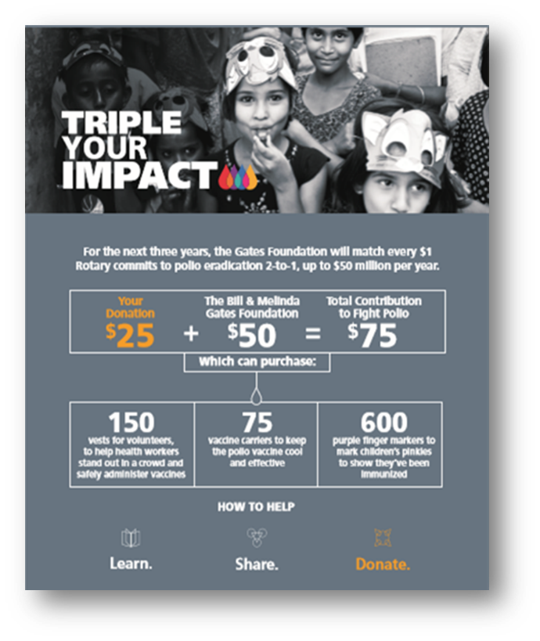
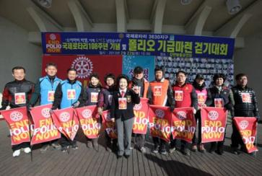
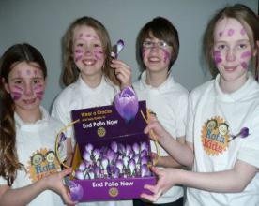

POLIOPLUS FUND
Notes:
Contributions to the PolioPlus Fund support polio eradication efforts around the world.
Rotary and the Bill & Melinda Gates Foundation are working together to End Polio Now.
From 2017 to 2023, every $1 that Rotary commits in direct support of polio immunization (up to $50 million per year) will be matched by an additional $2 from the Gates Foundation. This means your contributions to the PolioPlus Fund will have three times the impact.

Slide 7
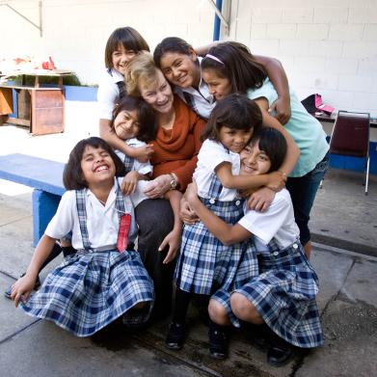
ROTARY’S ENDOWMENT
Contributions are professionally invested.
Only the earnings are spent.
Notes:
Gifts to the Endowment Fund are professionally invested, with part of the earnings used each year for purposes that the Trustees and donors specify. The principal portion of an Endowment gift is never spent and is held in perpetuity.
The Endowment offers donors a way to ensure a strong future for The Rotary Foundation.

Slide 8
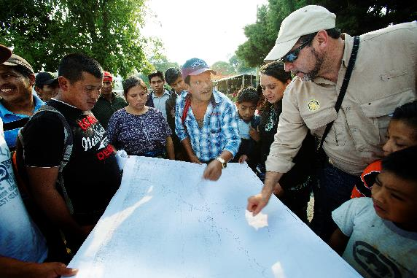
ANNUAL FUND
Funds Rotary grants
Contributions are credited to the donor’s club and applied to the club’s goal
Contributions generate District Designated Funds (DDF)
Notes:
Contributions to the Annual Fund support Foundation activities.
Contributions are credited to the donor and the donor’s club, and they count toward the club’s and district’s Annual Fund goals.
Contributions to the Annual Fund are SHARED back with the Districts and generate District Designated Funds (DDF), which are used to support local and international projects.

Slide 9


Slide 10
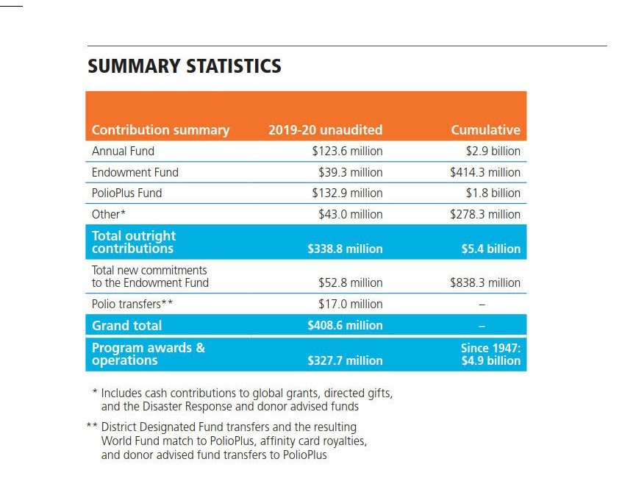

Slide 11
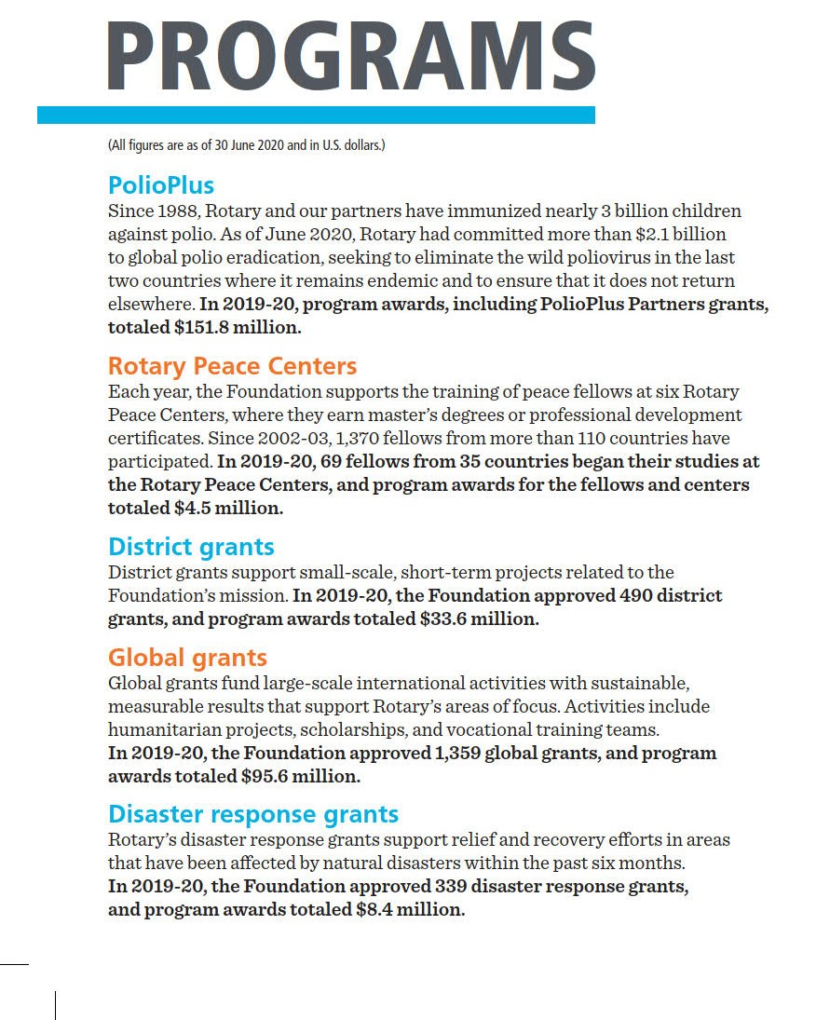
Notes:
Our Club has benefitted directly from the support of the Rotary Foundation. In the past 4 years our community work has been aided by 5 District and RI grants, all financed by Rotarians contributing to the RI Foundation.
In 2017 - Global Grant for Belize Literacy Phase I – DDF $8,000USD and GG $23,600USD
In 2020 - Global Grant for Belize Literacy Phase II – DDF $11,000USD and GG $18,610USD
In 2020 - District Grant for Operation Friendship Seniors Society – 50% 0f $5368 CAD
In 2021 - Global Scholarship Grant for Anna-Marie Robertson – DDF $10,000 and GG $10,000USD
In 2021 - District Grant for Operation Friendship Seniors Society – 50% 0f $5000 CAD
TOTAL GRANTS IN PAST 4 YEARS – APPROX. $112,000CAD
TOTAL VALUE OF THE FIVE PROJECTS - $201,000CAD

Slide 12
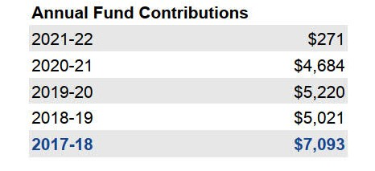
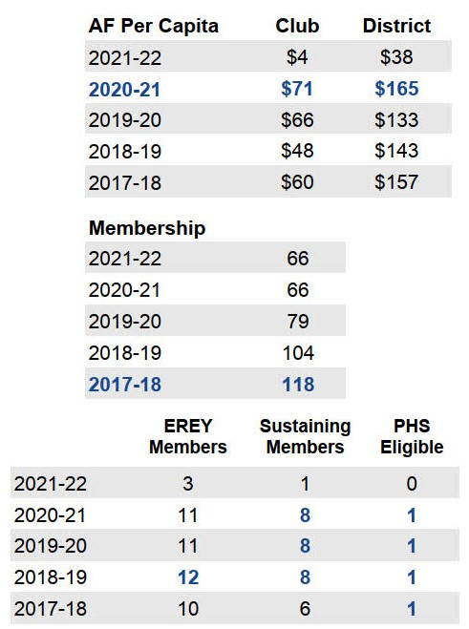
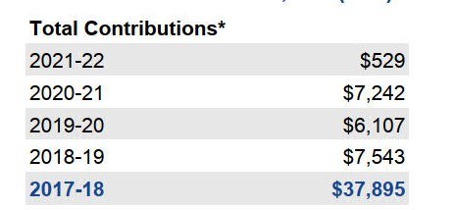
Notes:
How are we doing at supporting the RI Foundation?
In the previous Rotary year 11 members of our club contributed $7242 to the Rotary Foundation.
$4684 was directed to the Annual Fund which translates to $71 per capita for our Club but well below the average in our District of $165.

Slide 13
Can I Count On Your Support?
Watch For My Email

